Slide 1
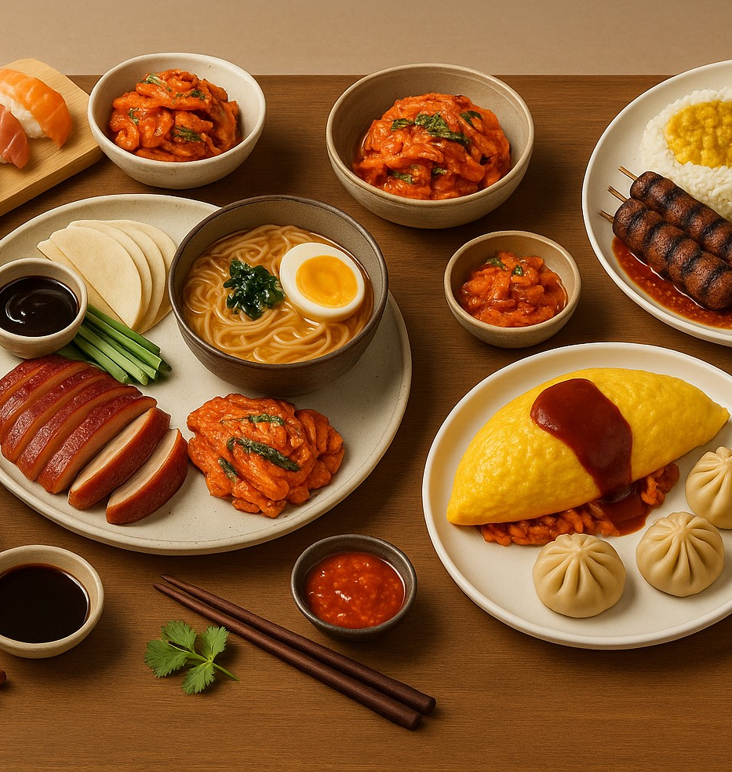
The Asian Fusion Musical Restaurant
A Culinary Experience with Rhythm
Presented by: Group-3
Leader: Suraj Kumar Thing
Web Programming – Final Project
Kyoto College of Graduate Studies for Informatics
July 2025

Slide 2

Team Introduction
Group Name: Group-3
Leader: Suraj Kumar Thing
Student ID: M24W0441
Team Members:
Subash Thapa- M23W7332
Rachana Panta- M24W0442
Project Role Distribution:
Website Design, Layout, Image, Media Editing, Presentation & Coordination – Suraj Kumar Thing
Content & Copywriting – Subash Thapa & Rachana Panta

Slide 3
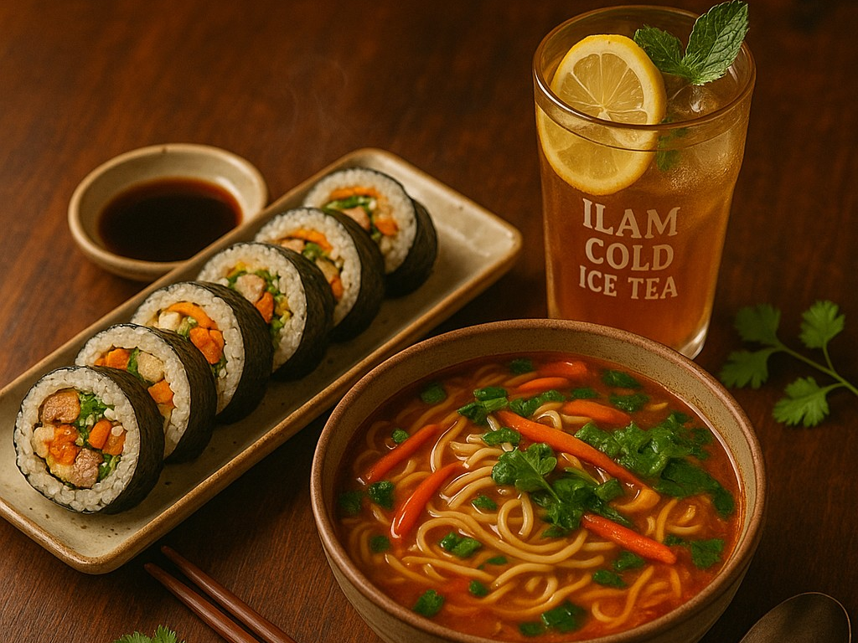
Project Overview
Goal: Create a responsive, animated restaurant website
Features:
- Menu & Specials
- Live music collaboration (GM JOON)
- Reservation system
- Contact & Social Media Integration
Technology Used:
- HTML5 & CSS3
- Responsive Design with Flex/Grid
- Animations with @keyframes

Slide 4
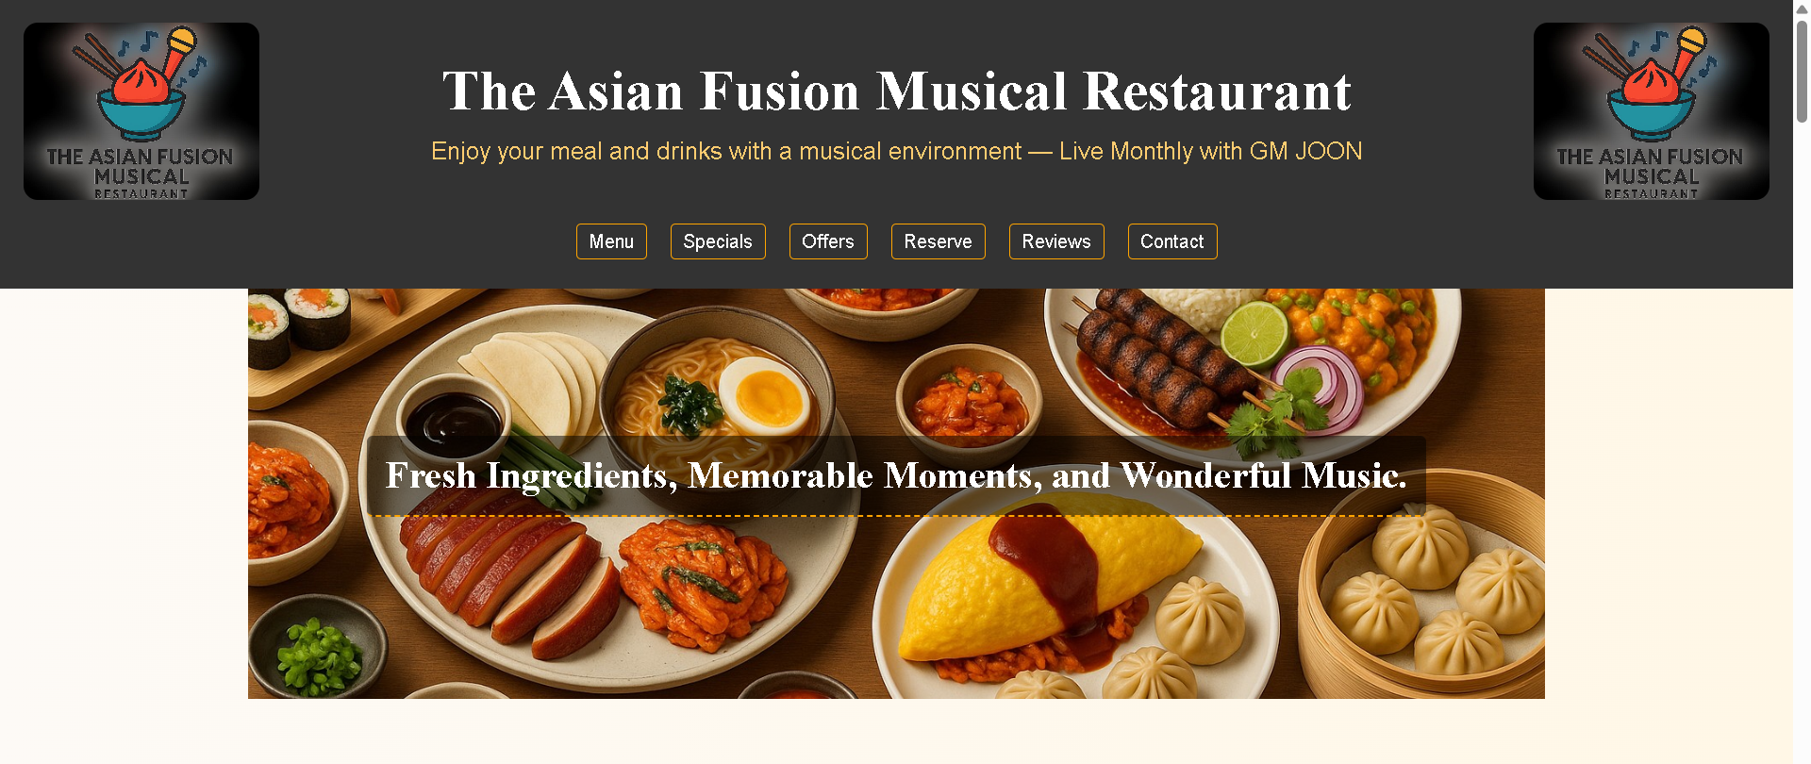
Homepage & Hero Section
Header Highlights:
Central logo with restaurant name and slogan
Navigation links
Hero Banner:
Text: 'Fresh Ingredients, Memorable Moments, and Wonderful Music'
Background image with animated slide-in text

Slide 5
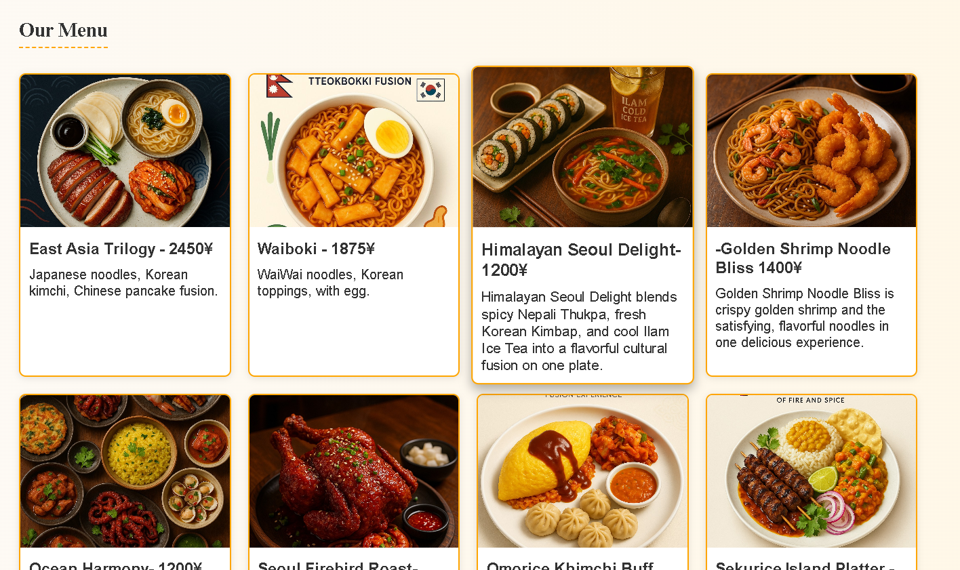
Menu Section
Section Title: Our Menu
Grid Cards: 8 fusion dishes
Popular Dishes:
Omorice Khimchi Buff MoMo
Sekurice Island Platter
East Asia Trilogy
Design: Hover effects with scaling and shadows

Slide 6
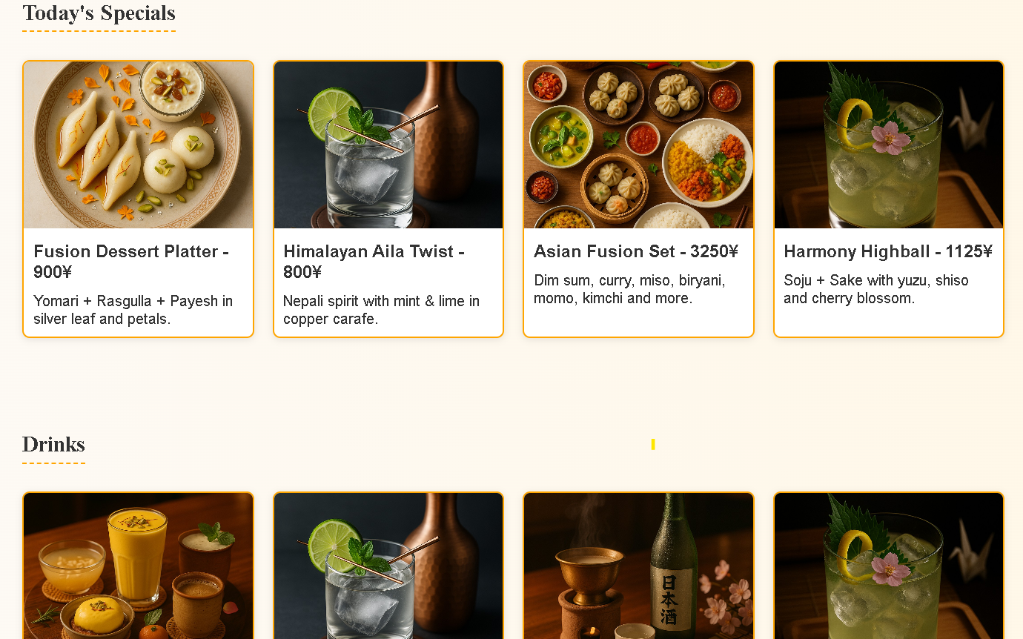
Specials & Drinks
Today's Specials:
Fusion Dessert Platter
Himalayan Aila Twist
Harmony Highball
Drink Highlights:
Sip of Asia
Spirits of the East

Slide 7
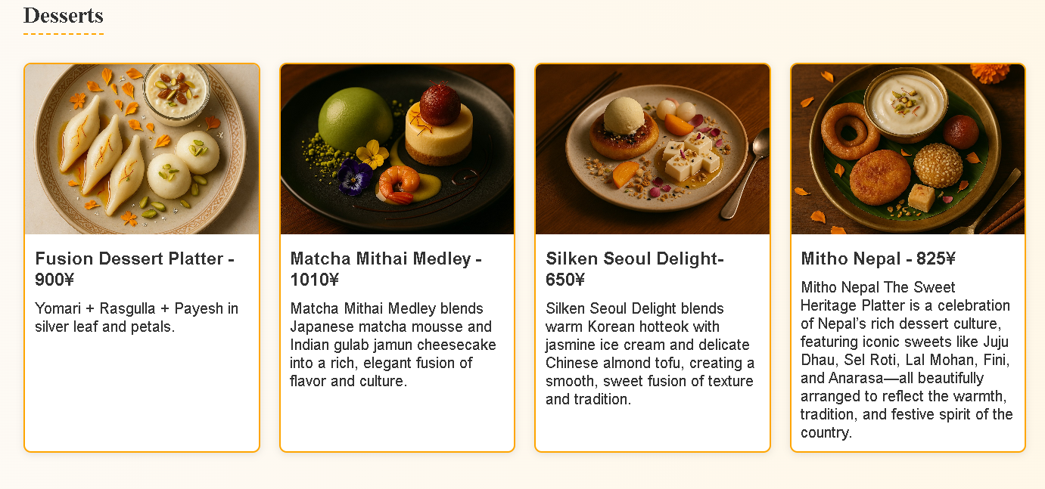
Desserts
Dessert Items:
Matcha Mithai Medley
Silken Seoul Delight
Mitho Nepal – Sweet Heritage Platter
Fusion of Japanese, Korean, Indian, and Nepali flavours

Slide 8
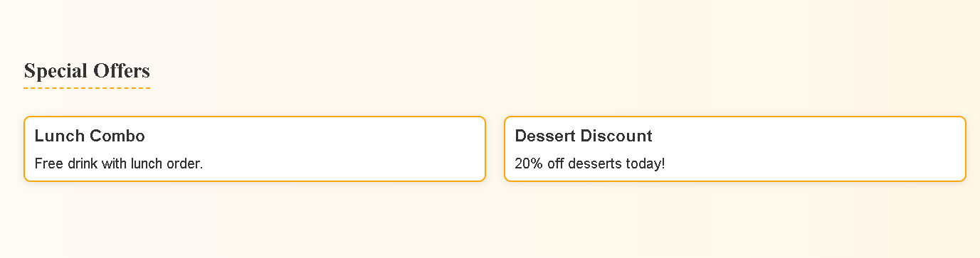
Special Offers
Offers Highlighted:
Lunch Combo (Free drink)
Dessert Discount (20% off)
Call to Action: Encourages customer engagement and loyalty

Slide 9
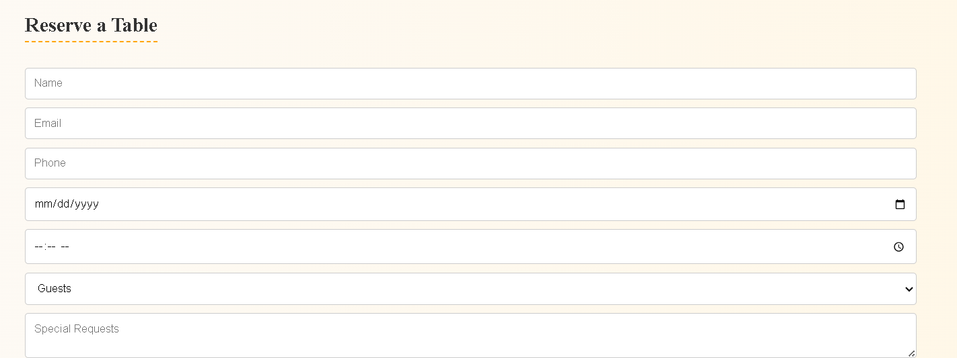

Reservation System
Fields Included:
Name, Email, Phone, Date & Time
Number of Guests
Special Requests
User-Friendly: Clean layout and form validation
Submit Redirect: thankyou.html

Slide 10
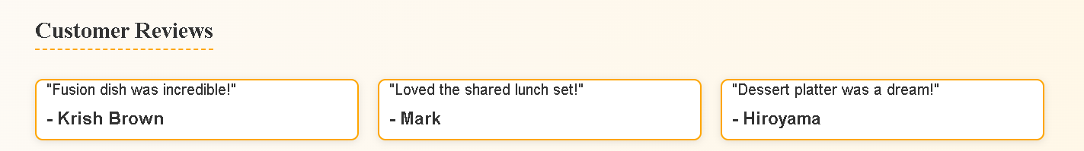
Customer Reviews
Testimonials:
“Fusion dish was incredible!” – Krish Brown
“Dessert platter was a dream!” – Hiroyama
Design: Grid layout with animated cards

Slide 11
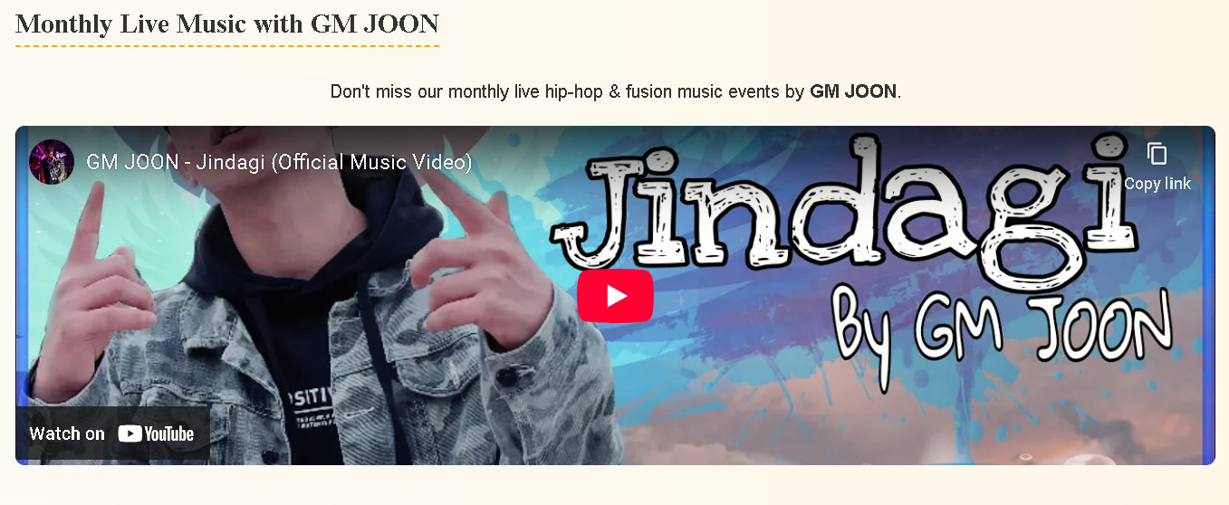
Monthly Live Music with GM JOON
Event: Monthly Live Hip-hop & Fusion Music
Performer: GM JOON
Media: Embedded YouTube video
Enhances atmosphere and branding

Slide 12
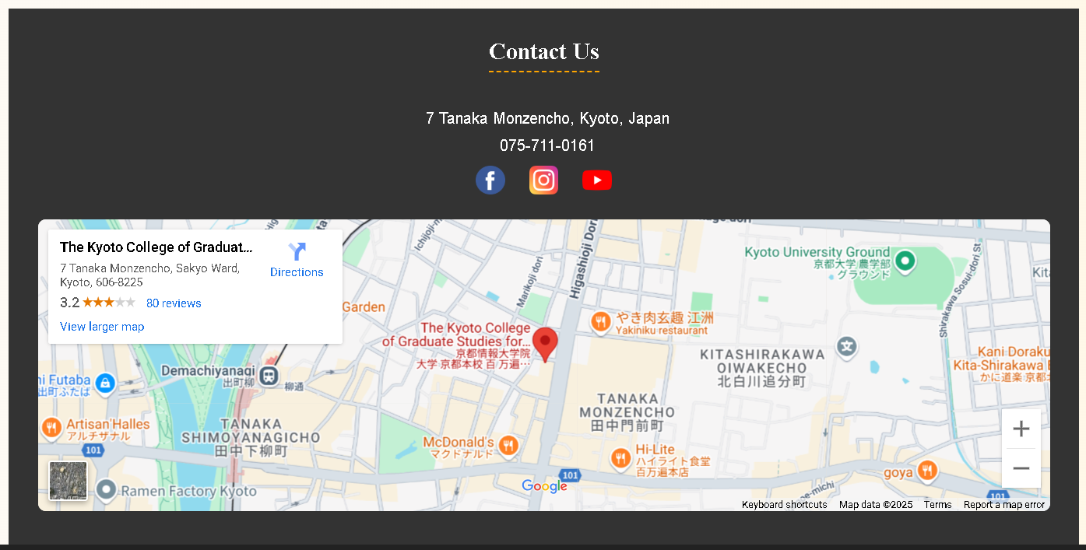
Contact & Location
Contact Info:
Address: Kyoto, Japan
Phone: 075-711-0161
Social Media:
Facebook, Instagram, YouTube
Map Integration: Embedded Google Maps

Slide 13
Summary & Branding
Design Highlights:
Responsive Grid & Flex Layouts
CSS Animations
Cultural and musical branding
Final Note:
“A place where cuisine and rhythm
blend into an unforgettable experience.”

